Slide 1
Marina Advisory Committee
Live-Aboard Increase Presentation
May 2nd 2019
By Marina Walker

Slide 2
Who is BCDC?
Mission: The San Francisco Bay Conservation and Development Commission (BCDC) protects and enhances San Francisco Bay and encourages the Bay's responsible and productive use for this and future generations.
When BCDC was established, only four miles of the Bay shoreline were open to public access. By drawing attention to the Bay, the Commission has played a major role in making the Bay and its shoreline a national recreational treasure.
The Commission has also approved thousands of new boat berths and has required that public access be provided along 139 miles of the shoreline as part of new waterfront projects. Now over 340 miles of the Bay shoreline are open to the public as part of the Bay Trail.
Notes:
“About Us.” Bcdc.ca.gov, BCDC, www.bcdc.ca.gov/aboutus/.

Slide 3
Current BCDC Permit:
Permit No. 1-86:
Use of a maximum of 5% of the total berths in the marina for live-aboards to provide security for the Vallejo Municipal Marina. House boats [vessels affixed to dock] are not authorized (Amendment No. Six).
Live-aboards must be distributed evenly throughout marina to function as security and surveillance.
Provide annual security reports.
Update BCDC anytime there is a change in a live-aboard location or use.
Permits last 10 years; must submit request to renew 90 days prior to end date.
Vallejo Marina currently has 34 live-Aboards; Two over the limit
Current Live-Aboard revenue is $7,700 monthly, $92,400 annually.
Notes:
Live-Aboard Plans. The final live-aboard plans submitted for review and approval, shall specifically show all facilities required herein for live-aboard use and the location and distribution of each berth designated for live-aboard use shall be generally consistent with the berthing plan submitted on April 28,'1995. Within ten days of any change in the location or use of any live-aboard boat or other vessel used-for residential purpose, the permittee shall submit a revised plan showing and describing the change.
Plans submitted shall be accompanied by a letter requesting plan approval, identifying the type of plans submitted, the portion of the project involved, and indicating whether the plans are final or preliminary. Approval or disapproval shall be based upon: (a) completeness and accuracy of the plans in showing the features required
above, particularly the mean high tide line, the line 5 feet above mean sea level in marshlands property lines, and the line 100 feet inland of the mean high tide line, and any other criteria required by this amended permit; (b) consistency of the plans with the terms and conditions of this amended permit; (c) the provision of the amount and quality of public access to and along the shoreline and in and through the project to the shoreline required by this amended permits (d) consistency with legal instruments reserving public access and open space areas; (e) assuring that any fill in the Bay does not exceed this amended permit and will consist of appropriate shoreline protection materials as determined by or on behalf of the Commission; (f) consistency of the plans with the recommendations of the Design Review Board; (g) consistency of the plans with the recommendations of the Engineering Criteria Review Board; and (h) assuring that appropriate provisions have been incorporated for safety in case of a seismic event. Plan review shall be completed by or on behalf of the Commission within 45 days after receipt of the plans to be reviewed.

Slide 4
Process to Amend Permit
Step 1
City will need to submit a request for an amendment to the existing permits for the marina (1986.001.12 and 1982.009.06) by submitting a permit amendment application.
BCDC would need to find the proposal consistent with the Commission's laws and policies in the San Francisco Bay Plan, especially Recreation Policy 3 c.
Notes:
Live-aboard boats. Live-aboard boats should be allowed only in marinas and only if: (1) The number would not exceed ten percent of the total authorized boat berths unless the applicant can demonstrate clearly that a greater number of live-aboard boats is necessary to provide security or other use incidental to the marina use; (2) The boats would promote and further the recreational boating use of the marina (for example, providing a degree of security), and are located within the marina consistent with such purpose; (3) The marina would provide, on land, sufficient and conveniently located restrooms, showers, garbage disposal facilities, and parking adequate to serve live-aboard boat occupants and guests; (4) The marina would provide and maintain an adequate number of vessel sewage pumpout facilities in locations that are convenient in location and time of operation to all boats in the marina, particularly live-aboard boats, and would provide the service free of charge or at a reasonable fee; and (5) There would be adequate tidal circulation in the marina to mix, dilute, and carry away any possible wastewater discharge. Live-aboard boats moored in a marina on July 1, 1985, but unauthorized by the Commission, should be allowed to remain in the marina provided the tests of (2), (3), (4), and (5) above are met. Where existing live-aboard boats in a marina exceed ten percent of the authorized berths, or a greater number is demonstrated to be clearly necessary to provide security or other use incidental to the marina use, no new live-aboard boats should be authorized until the number is reduced below that number and then only if the project is in conformance with tests (1), (2), (3), (4), and (5) above.
“Processing Permit Applications.” Bcdc.ca.gov, BCDC, www.bcdc.ca.gov/permits/processing_permit.html.

Slide 5
Process to Amend Permit, Cont.
Step 2
The Commission's staff will send a pending application notice to the applicant who must post the notice at the project site. The applicant must return a form to the Commission certifying that the notice has been posted as a filing requirement.
The Design Review Board's evaluation of a proposed project is normally scheduled to take place prior to the Commission's public hearing on the application.
To assist the Commission in evaluating the appearance, design, and scope of proposed public access of applications for significant projects are evaluated by the Commission's Design Review Board, an advisory board made up of: prominent architects; landscape architects; engineers; and other design professionals.
Notes:
“Processing Permit Applications.” Bcdc.ca.gov, BCDC, www.bcdc.ca.gov/permits/processing_permit.html.

Slide 6
Process to Amend Permit, Cont.
Step 3
BCDC meetings are held at 1:00 p.m. on the first and third Thursdays of the month. A meeting notice is provided to applicants and other interested parties at least 10 days before the Commission meeting.
The Commission typically takes one or two meetings to consider and act on an application.
Thirteen members of the 27-member Commission must vote in favor of a project in order for a project to be approved.
The hearing is followed by the Commission's staff whom presents its recommendation and, then, the Commission votes on the application. The applicant (or applicant's representative) has an opportunity to comment on the staff's recommendation before the Commission votes.
Notes:
1. The notice indicates what matters the Commission will consider and specifies the date, time and location of the meeting.
2. The public hearing is held at the first meeting. The applicant or applicant's representative describes the project. Ten minutes is usually allowed for the applicant's presentation. After the presentation, there is a public hearing during which members of the public also have an opportunity to express their views on the project. Each member of the public has three minutes to speak.
4. The two members of the Commission who represent federal agencies cannot vote on permits. [Government Code section 66632, Public Resources Code sections 29520 et seq, and California Code of Regulations, sections 10360 et seq, 10400 et seq and 10550 et seq]
“Processing Permit Applications.” Bcdc.ca.gov, BCDC, www.bcdc.ca.gov/permits/processing_permit.html.

Slide 7
If we are approved…
Potential INFRASTRUCTURE NEEDS & Estimated COST
TOTAL INCOME FOR 64 LIVE-ABOARDS
Add showers at K Dock - $15,000-$20,000
Remodel and add showers in building 7 - $20,000-$25,000
Approximately $14,400 per month – A $6,700 increase each month; $172,800 per year, $80,400 increase annually.

Slide 8
Marina Occupancy
The Vallejo Marina has 647 slips
44.3% Capacity
97 of remaining 364 slips are rentable. 267 slips are not rentable due to silt.

Slide 9
J Dock Dredging Fall 2019
149 slips; 92 vacant
Standard rate potential $55,728.88 if all slips were occupied
Notes:
Standard Rate Potential: Rent which would be collected in a month if all slips in this sort group were rented at the base rate

Slide 10
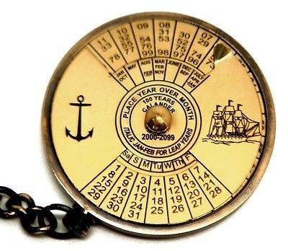
Timeline
The entire process may take approximately 120 days from request submittal to amended permit issued.

Slide 11
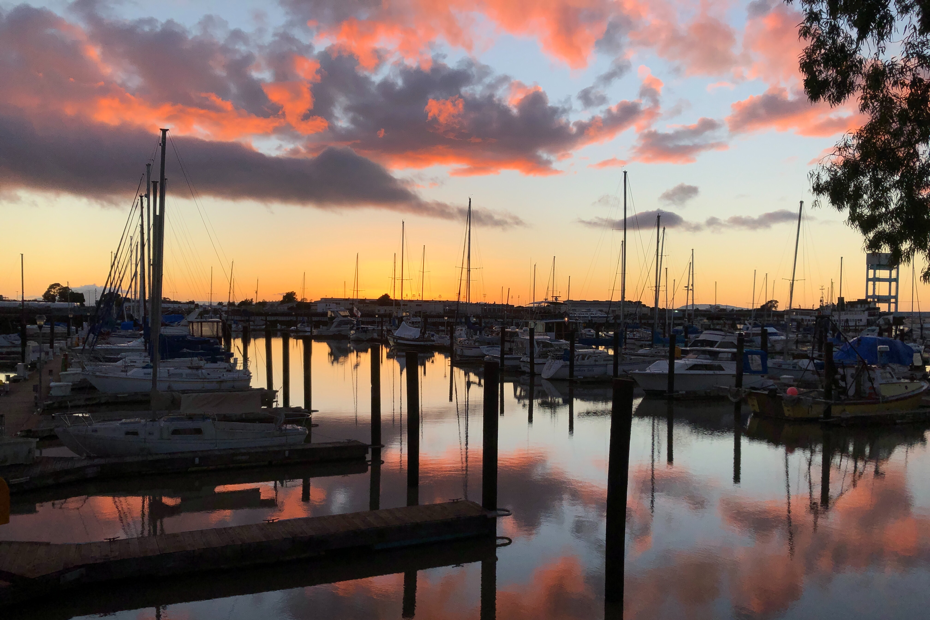
Q & A / Comments
Q & A / Comments
Picture taken by: Berther, Chris Harrod in 02/2019

